Slide 1
Algebraic Structures
SY Odd 2021-22

Slide 2
Syllabus
Algebraic Structures 11 CO4
Algebraic structures with one binary operation: semigroup, monoids and groups
Cyclic groups, Normal subgroups
Hamming Code ,Minimum Distance
Group codes ,encoding-decoding techniques
Parity check Matrix ,Maximum Likelihood
Mathematics of Cryptography - Modular Arithmetic, Matrices, Linear Congruence, GF Fields, Primes and Related Congruence Equations- Primes, Primality Testing, Factorization, Quadratics Congruence, Chinese reminder theorem, Exponentiation and Logarithm.

Slide 3
Algebraic systems
N = {1,2,3,4,…..∝ } = Set of all natural numbers.
Z = { 0, ± 1, ± 2, ± 3, ± 4 , ….. ∝} = Set of all integers.
Q = Set of all rational numbers, R = Set of all real numbers.
Binary Operation: The binary operator * is said to be a binary operation
(closed operation) on a non empty set A, if
a * b ∈ A for all a, b ∈ A (Closure property).
Ex:The set N is closed with respect to addition and multiplication
but not w.r.t subtraction and division.
Algebraic System: A set ‘A’ with one or more binary(closed) operations defined on it is called an algebraic system.
Ex: (N, + ), (Z, +, – ), (R, +, . , – ) are algebraic systems.

Slide 4
Properties
Commutative: Let * be a binary operation on a set A.
The operation * is said to be commutative in A if
a * b= b * a for all a, b in A
Associativity: Let * be a binary operation on a set A.
The operation * is said to be associative in A if
(a * b) * c = a *( b * c) for all a, b, c in A
Idempotent : Let * be a binary operation on a set A.
The operation * is said to be idempotent in A if
a * a = a

Slide 5
Semi group
Semi Group: An algebraic system (A, *) is said to be a semi group if
* is closed operation on A.
* is an associative operation, for all a, b, c in A.
Ex. (N, +) is a semi group.
Ex. (N, . ) is a semi group.
The semigroup (A, ∗) is said to be commutative if ∗ is a commutative operation.
The set P(S) where S is a set, together with the operation of union is a commutative semigroup.
The set Z with the binary operation of subtraction is not a semigroup, since subtraction is not associative.

Slide 6
The set P(S) where S is a set, together with the operation of union is a commutative semigroup
S={1,2}
P(S)={nullset, {1},{2},{1,2}}
(p(s),union)=closed? Yes
Associative? Yes ---Semigroup for any a,b belonging to P(S)
a union b =b union a Commutative semigroup
snistforum.com

Slide 7
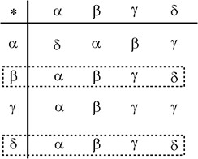
Left Identity
Let (A, ∗) be an algebraic system where ∗ is a binary operation on A. An element in A, e, is said to be a left identity if for all x in A, e ∗ x = x. For example for the algebraic system shown in Fig. both β and δ are left identifies.
β ∗ α | = | α | δ ∗ α | = α
β ∗ β | = | β | δ ∗ β | = β
β ∗ γ | = | γ | δ ∗ γ | = γ
β ∗ δ | = | δ | δ ∗ δ | = δ

Slide 8
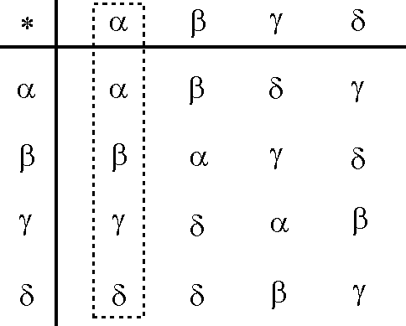
Right Identity
An element in A, e is said to a right identity if for all x in
A. x ∗ e = x. For example, for the algebraic system shown in Fig. α is a right identity.

Slide 9
Identity
An element is said to be an identity if it is both a left identity and a right identity.
Let W={0,1,2,3,4,……}
Then (W, +) is an algebraic system.
Clearly 0 is the identity of the algebraic system.

Slide 10
Monoid
Monoid: An algebraic system (A, *) is said to be a monoid if the following
conditions are satisfied.
* is a closed operation in A.
* is an associative operation in A.
There is an identity in A.

Slide 11
Monoid
Ex. Show that the set ‘N’ is a monoid with respect to
multiplication.
Solution: Here, N = {1,2,3,4,……}
Closure property :We know that product of two natural numbers is again a natural number.
i.e., a.b ∈ N for all a,b ∈ N
∴ Multiplication is a closed operation.
2. Associativity : Multiplication of natural numbers is associative.
i.e., (a.b).c = a.(b.c) for all a,b,c ∈ N
3. Identity : We have, 1 ∈ N such that
a.1 = 1.a = a for all a ∈ N.
∴ Identity element exists, and 1 is the identity element.
Hence, N is a monoid with respect to multiplication.

Slide 12
Monoid
Example: Is (p(s),U) a monoid?

Slide 13
Sub-semigroup & sub-monoid
Subsemigroup : Let (S, * ) be a semigroup and let T be a subset of S.
If T is closed under operation * , then (T, * ) is called a subsemigroup of (S, * ). Ex: (N, .) is semigroup and T is set of multiples of positive integer m then (T,.)
is a sub semigroup.
N={1,2,3,4,5,…………..},(N,*) semigroup
T={2,4,6,8,10,12,14,………..} (T,*) sub-semigroup
Submonoid : Let (S, * ) be a monoid with identity e, and let T be a non- empty subset of S. If T is closed under the operation * and e ∈ T, then (T, *
) is called a submonoid of (S, * ).
(P(S),Union)-Monoid, T={null,{a},{b},{a,b}} sub-monoid

Slide 14
Inverse
Let (A, *) be an algebraic system with an identity e. Let a be an element in A. An element b is said to be a left inverse of a if b * a = e. An element b is said to be a right inverse of a if a * b = e. For example for the algebraic system shown in Fig. a is an identity. So b is a left inverse of g, and d is a right inverse g
An element b is said to be an inverse of a, if it is both a left and a right inverse of a. Clearly if b is an inverse of a, a is also an inverse of b.
* | a | b | g | d
a | a | b | g | d
b | b | d | a | g
g | g | b | b | a
d | d | a | g | d

Slide 15
Group
Group: An algebraic system (G, *) is said to be a group if the following conditions are satisfied.
* is a closed operation.
* is an associative operation.
There is an identity in G.
Every element in G has inverse in G.
Abelian group (Commutative group): A group (G, *) is
said to be abelian (or commutative) if
a * b = b * a for all a, b belongs to G.

Slide 16
Group
A group (A, *) is said to be finite group, if A is a finite set and infinite group, if A is an infinite set.The size of A is often referred to as the order of the group.
E.g. (i) The group (Z, +) is of infinite order. (ii) The group (Zm, +) is of finite order viz m.

Slide 17
Theorems –Self Study
In a Group (G, * ) the following properties hold good
Identity element is unique.
Inverse of an element is unique.
Cancellation laws hold good
a * b = a * c ⇒ b = c
a * c = b * c ⇒ a = b
(left cancellation law)
(Right cancellation law)
4. (a * b) ⁻¹ =
_{b}-1 _{* a}-1
In a group, the identity element is its own inverse.

Slide 18
Ex. Show that, the set of all integers is an abelian group with respect to addition.
Solution: Let Z = set of all integers. Let a, b, c are any three elements of Z.
1. Closure property :We know that, Sum of two integers is again an integer.
i.e., a + b ∈ Z for all a,b ∈ Z
2. Associativity: We know that addition of integers is associative.
i.e., (a+b)+c = a+(b+c)
3. Identity : We have 0 ∈ Z and
for all a,b,c ∈ Z.
a + 0 = a for all a ∈ Z .
∴ Identity element exists, and ‘0’ is the identity element.
Inverse: To each a ∈ Z , we have – a ∈ Z such that
a + ( – a ) = 0 Each element in Z has an inverse
Commutativity: We know that addition of integers is commutative.
i.e., a + b = b +a for all a,b ∈ Z.
Hence, ( Z , + ) is an abelian group.

Slide 19
Ex. Show that set of all non zero real numbers is a group with respect to multiplication .
Solution: Let R* = set of all non zero real numbers.
Let a, b, c are any three elements of R* .
1. Closure property :We know that, product of two nonzero real numbers is again a nonzero real number .
i.e., a . b ∈ R* for all a,b ∈ R* .
2. Associativity: We know that multiplication of real numbers is associative.
i.e., (a.b).c = a.(b.c) for all a,b,c ∈ R* .
Identity : We have 1 ∈ R* and a .1 = a for all a ∈ R* .
∴ Identity element exists, and ‘1’ is the identity element.
Inverse: To each a ∈ R* , we have 1/a ∈ R* such that
a .(1/a) = 1 i.e., Each element in R* has an inverse.
Commutativity: We know that multiplication of real numbers is commutative.
i.e., a . b = b . a for all a,b ∈ R*.
Hence, ( R* , . ) is an abelian group.

Slide 20
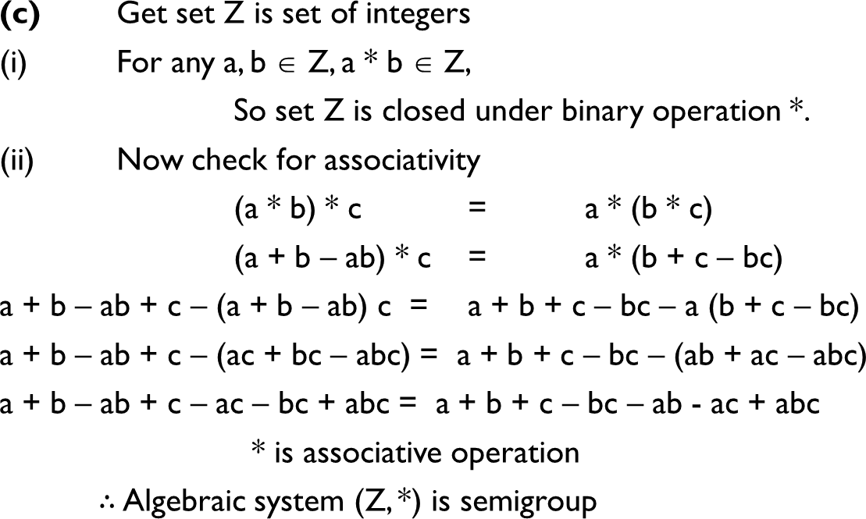
Ex. Determine whether the set Z together with the binary operation a*b where a * b = a + b – ab is a semigroup, a monoid or neither. Also determine if it is commutative.
🞂

Slide 21
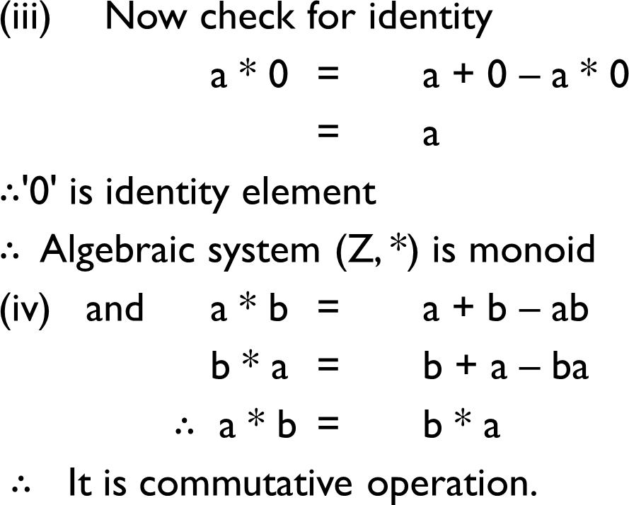
🞂

Slide 22
Modulo systems
Addition modulo m ( +_{m} )
let m be a positive integer. For any two positive integers a and b
a +_{m} b = a +_{m} b =
a + b if a + b < m r if a + b ≥ m
where r is the remainder obtained
by dividing (a+b) with m.
Ex. 14 +₆ 8 = 22 % 6 = 4
Ex. 9 +₁₂ 3= 12 % 12 = 0
Multiplication modulo p ( ×_{p} )
let p be a positive integer. For any two positive integers a and b
a ×_{p} b = a ×_{p} b =
a b if a b < p r if
a b ≥ p where r is the remainder obtained
by dividing (ab) with p.
Ex. 3 ×₅
4 = 2 , 5 ×₅ 4 = 0 , 2 ×₅ 2 = 4

Slide 23
Ex. : Show that the set G = {0,1,2,3,4,5} is a group with respect to addition modulo 6.
Solution:The composition table of G is
+₆ 0 1 2 3
4 5
0 1 2 3 4 5
1 2 3 4 5 0
2 3 4 5 0 1
3 4 5 0 1 2
4 5 0 1 2 3
5 0 1 2 3 4
0
1
2
3
4
5
1. Closure property: Since all the entries of the composition table are the elements of the given set, the set G is closed under +₆ .

Slide 24
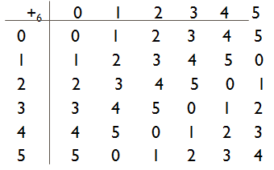
Contd.,
Associativity: The binary operation +₆ is associative in G.
for ex. (2 +₆ 3) +₆ 4 = 5 +₆ 4 = 3 and
2 +₆ ( 3 +₆ 4 ) = 2 +₆ 1 = 3
Identity : 0 is the identity element.
. Inverse: From the composition table, we see that the inverse elements of 0, 1, 2, 3, 4, 5 are 0, 5, 4, 3, 2, 1 respectively.
Commutativity: The corresponding rows and columns of the table are identical.Therefore the binary operation +₆ is commutative.
Hence, (G, +₆ ) is an abelian group.

Slide 25
Ex. : Show that the set G = {1,2,3,4,5,6} is a group with respect to multiplication modulo 7.
Solution:The composition table of G is
×₇ | 1 | 2 | 3 | 4 | 5 | 6
1 | 1 | 2 | 3 | 4 | 5 | 6
2 | 2 | 4 | 6 | 1 | 3 | 5
3 | 3 | 6 | 2 | 5 | 1 | 4
4 | 4 | 1 | 5 | 2 | 6 | 3
5 | 5 | 3 | 1 | 6 | 4 | 2
6 | 6 | 5 | 4 | 3 | 2 | 1
1. Closure property: Since all the entries of the composition table are the
elements of the given set, the set G is closed under ×₇ .

Slide 26
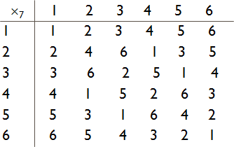
Contd.,
Associativity: The binary operation ×₇ is associative in G. for ex. (2 ×₇ 3) ×₇ 4 = 6 ×₇ 4 = 3 and
2 ×₇ ( 3 ×₇ 4 ) = 2 ×₇ 5 = 3
Identity : 1 is the identity element.
. Inverse: From the composition table, we see that the inverse elements of 1, 2, 3, 4. 5 ,6 are 1, 4, 5, 2, 3, 6 respectively.
Commutativity: The corresponding rows and columns of the table are identical.Therefore the binary operation ×₇ is commutative.
Hence, (G, ×₇ ) is an abelian group.

Slide 27
Ex. : Let Z4 i.e. G = {0, 1, 2, 3}
Prepare its composition table with respect to ‘x4’
Is it a group ?
Let G = { 0, 1, 2, 3,}
(i) Composition table with respect to ‘X4’
X4 | 0 | 1 | 2 | 3
0 | 0 | 0 | 0 | 0
1 | 0 | 1 | 2 | 3
2 | 0 | 2 | 0 | 2
3 | 0 | 3 | 2 | 1
(ii) (a) The set G is closed under the operation X4 because all elements
belongs to composition table are belong to set G.

Slide 28
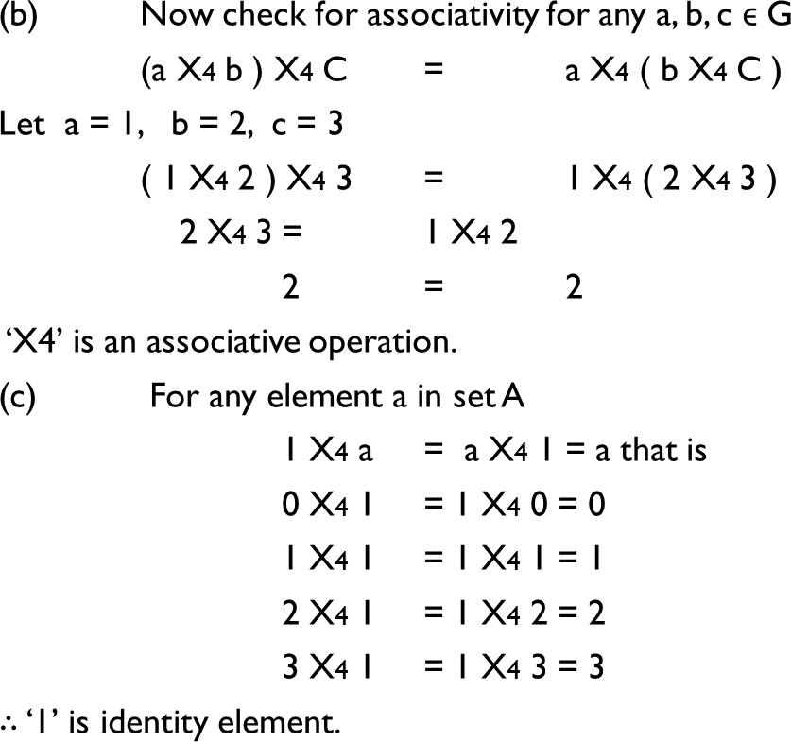
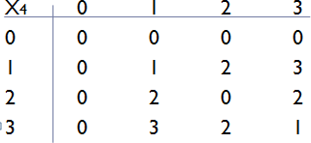
🞂

Slide 29
Inverse of 1 is 1
Inverse of 3 is 3
0 and 2 do not have inverse.
SO, (G, ×4) is not a group.

Slide 30
Cyclic group
A cyclic group is a group that can be generated by a single element.
Every element of a cyclic group is a power of some specific element which is called a generator.
A cyclic group can be generated by a generator ‘g’, such that every other element of the group can be written as a power of the generator ‘g’.

Slide 31
Subgroup
Let (A, *) be a group and B be a subset of A, (B, *) is said to be a subgroup of A if (B, *) is also a group by itself.
Suppose we want to check whether (B, *) is a subgroup for a given subset B of A.We note that
1.We should test whether * is a closed operation on B. 2.* is known to be an associative operation.
3.The identity of (A, *) must be in B as the identity of (B, *) 4.Since the inverse of every element in A is unique for every element b in B, we must check that its inverse is also in B.

Slide 32
Generation of Subgroups
Let (G, *) be a group and let S be a non-empty subset of G. Then the subgroup generated by S, denoted by < S > is defined as
(i)If x is an element of S, then x is also an element of < S >.
(ii)
if x is in < S >, then x–1 is also in < S >
if x and y are in < S > then x * y is also in < S > Only elements obtained by a finite number of
(iii)
iterations of (a) and (b) are in < S >.
Step (i) :Guarantees that the set S is contained in < S >
Step (ii) : Guarantees that < S > is a subgroup of G.

Slide 33
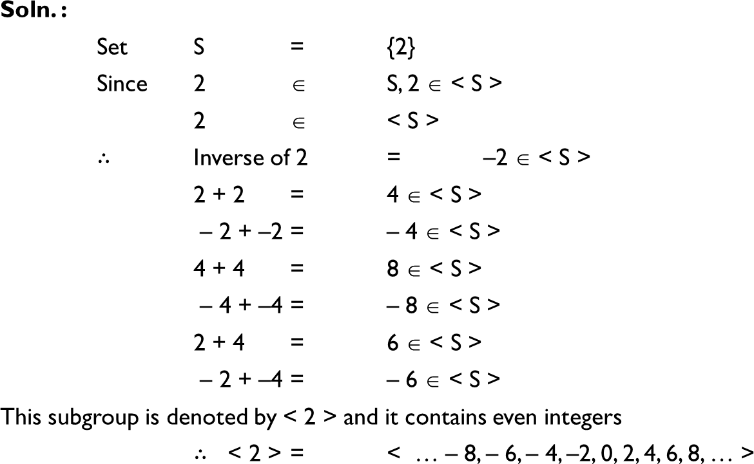
Ex. : Generate subgroup by 2 in (Z, +). For set (Z, +) identity element is '0'.
🞂

Slide 34
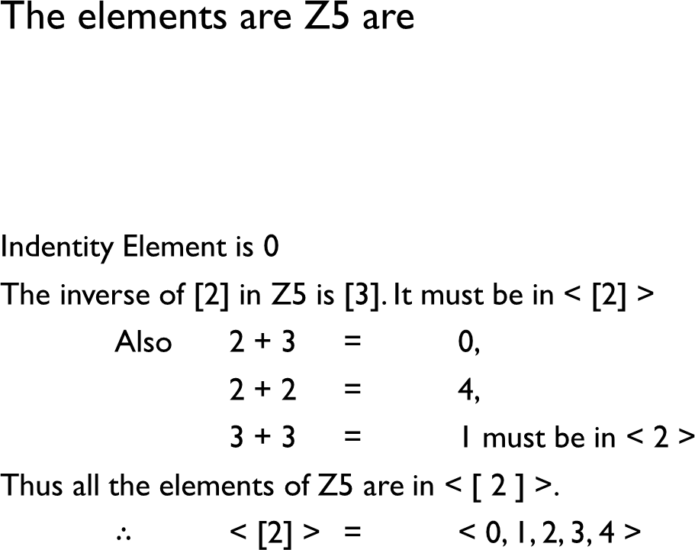
Ex. :Find the subgroup generated by [2] in Z5
🞂
+5 | 0 | 1 | 2 | 3 | 4
0 1 2 3 4 | 0 1 2 3 4 | 1 2 3 4 0 | 2 3 4 0 1 | 3 4 0 1 2 | 4 0 1 2 3

Slide 35
Ex. : Consider the set A = {1, 2, 3, 4, 5, 6} under the
multiplication modulo 7.
(a)Find the multiplication table for the above (b)Find the inverses of 2, 3 and 5, 6
Prove that it is a cyclic group
Find the orders and the subgroups generated by {3, 4} and {2, 3}
Multiplication modulo 7 table for set A is :
Solution:
×7 |  |  |  |  | 2 | 3 | 4 | 5 | 6
 |  |  | 1
 | 1 |  | 1 |  | 2 | 3 | 4 | 5 | 6
2 3 4 5 6 |  |  | 2 3 4 5 6 |  | 4 6 1 3 5 | 6 2 5 1 4 | 1 5 2 6 3 | 3 1 6 4 2 | 5 4 3 2 1
1 ×7 1 = | 1 | ×7 1 = 1
2 ×7 1 = | 1 | ×7 2 = 2
3 ×7 1 = | 1 | ×7 3 = 3
4 ×7 1 = | 1 | ×7 4 = 4
5 ×7 1 = | 1 | ×7 5 = 5
6 ×7 1 = | 1 | ×7 6 = 6
Identity element :1
2 and 4 are inverse of each other. 3 and 5 are inverse of each other. Inverse of 6 is 6

Slide 36
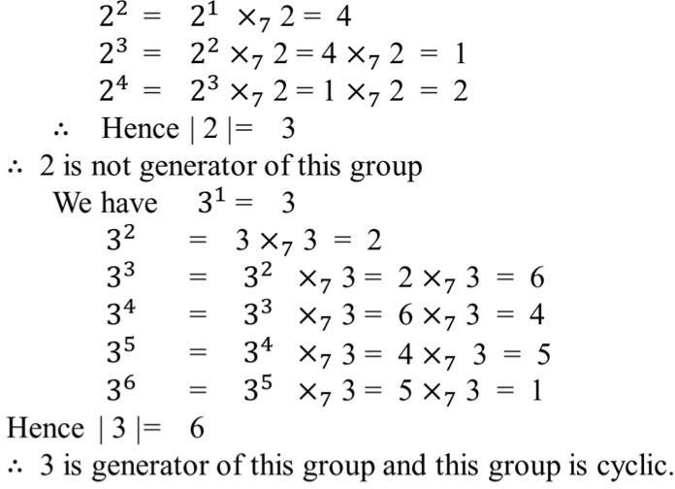
×7 | 1 | 2 | 3 | 4 | 5 | 6
1 2 3 4 5 6 | 1 2 3 4 5 6 | 2 4 6 1 3 5 | 3 6 2 5 1 4 | 4 1 5 2 6 3 | 5 3 1 6 4 2 | 6 5 4 3 2 1

Slide 37
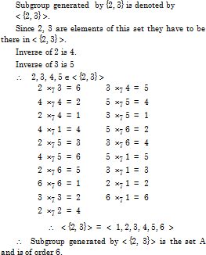
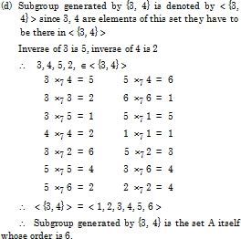

Slide 38
Coset
Let (G, *) be a group and let H be a subgroup of G. For a, b ∈ G, we say a is congruent to b modulo H, written as a ≡ b mod H, if a * b–1 ∈ H. One can easily see that the congruence relation is an equivalence relation on G. It therefore partitions G into equivalent classes called as cosets of H. The set of these equivalence classes is also called as the quotient set of G by H.
Let H be a subgroup of a group (G, *). For a ∈ G define
Ha = {h * a | h ∈ H} then Ha is called a right coset of H in G.
aH = {a * h | h ∈ H}
is called a left coset of H in G.
a is called as the representative element of the coset aH or Ha. If a ∈ H, then Ha = aH = H.
Hence the right cosets of H in G partition G into disjoint subsets. Likewise
the left cosets of H in G yield a portion of G into disjoint subsets.

Slide 39
Normal Subgroup
A subgroup H of G is said to be a normal subgroup of G if for every a ∈ G, aH = Ha.
A subgroup of an Abelian group is normal.

Slide 40
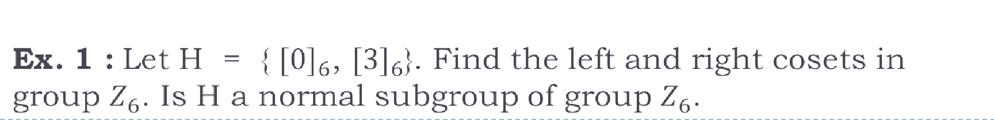
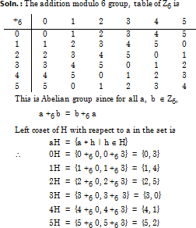
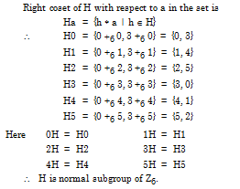
snistforum.com

Slide 41


Groups and Coding
We first choose an integer n > m and a one to one function e : Bm -> Bn.The function e is called as (m, n) encoding function, and we view it as a means of representing every word in Bm as a word in Bn. If b ∈ Bm, then e (b) is called the code word representing b.
We now transmit the code words by means of a transmission channel.Then each code word x = e(b) is received as the word xt in Bn.

Slide 42
Groups and Coding
Encoding function e to be one to one so that different words in Bm will be assigned
different code words.
If the transmission channel is noiseless, then xt = x for all x in Bn. In this case x
= e(b) is received for each b ∈ Bm and since e is a known function, b may be identified.
In general, errors in transmission do occur.We will say that the code word x = e(b) has been transmitted with k or fewer errors if x and xt differ in at least 1 but no more than k positions.
snistforum.com

Slide 43
Weight
If x ∈ Bn, then the number of 1's in x is called the weight
of x and is denoted by |X|.
Find the weight of each of the following words in B5:
 | (a) | x | = | 01000 | (b) | x | = | 11100
 | (c) | x | = | 00000 | (d) | x | = | 11111
Soln. :
(a) | x |  | = | 1
(b) | x |  | = | 3
(c) | x |  | = | 0
(d) | x |  | = | 5
snistforum.com

Slide 44
Hamming Distance
Let x and y be words in Bm. The hamming distance d (x, y) between x and y is the weight, of x ⊕ y. Thus the distance between x = x1 x2 … xm and y = y1 y2 … ym is the number of values of i such that xi ≠ yi, that is, the number of positions in which x and y differ.
Ex. Find the distance between x and y.
(a) x | = | 110110, | y | = | 000101
(b) x | = | 001100, | y | = | 010110
(c) x | = | 1100010, | y | = | 1010011
(d) x | = | 0100100, | y | = | 0011010
Soln. : (a) x ⊕ y = 110011 so | x ⊕ y |= 4
(b) x ⊕ y = 011010 so | x ⊕ y |= 3
(c) x ⊕ y = 0110001 so | x ⊕ y |= 3
(d) x ⊕ y = 0111110 so | x ⊕ y |= 5

Slide 45
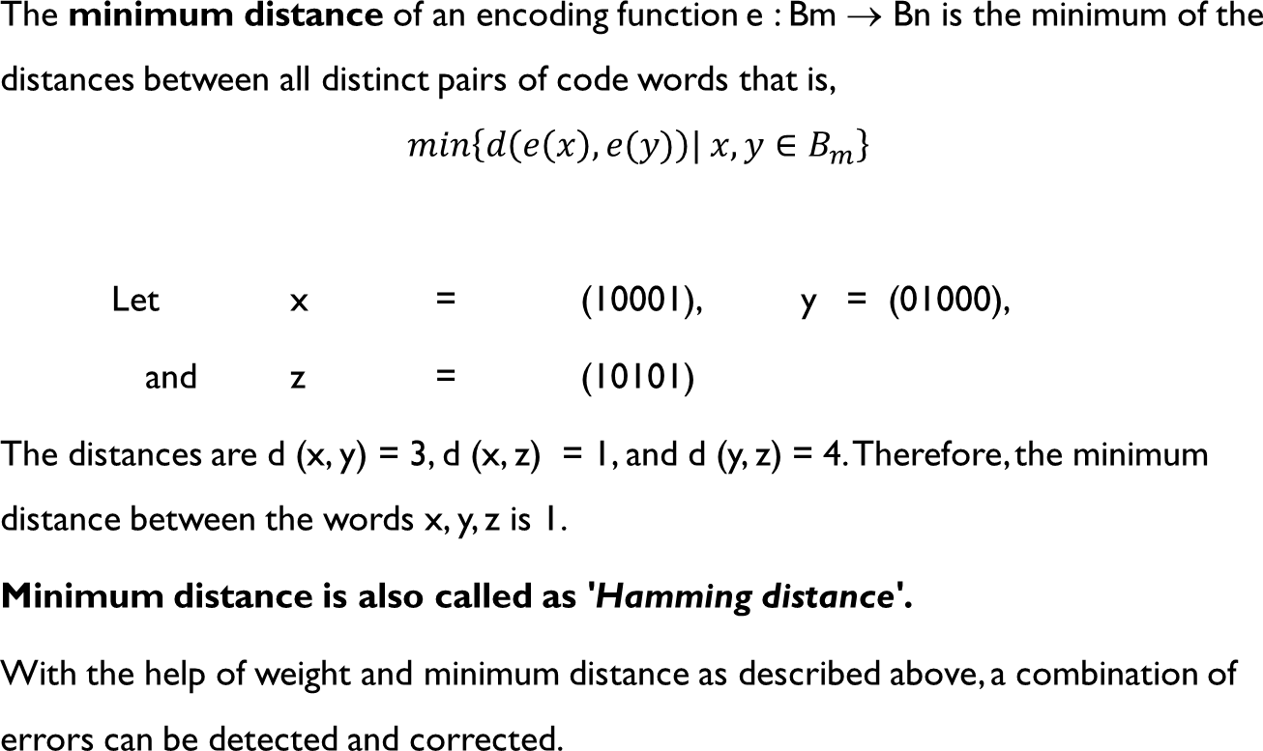
Minimum Distance
🞂

Slide 46
Theorems
The minimum weight of all non zero words in a group code is equal to its minimum distance
A code can detect all combinations of k or fewer iff the minimum distance between any two code words is at least k + 1
A code can correct all combinations of k or fewer errors iff the minimum distance between any two code words is at least 2 k + 1

Slide 47
Ex. 1 : Consider the (2, 4) encoding function. How many errors
will e detect ?
e (00) = 0000 e (10) = 0110
e (01) = 1011 e (11) = 1100
Soln:We first find distances between pairs of code words
d (0000, 0110) | = | 2
d (0000, 1011) | = | 3
d (0000, 1100) | = | 2
d (0110, 1011) | = | 3
d (0110, 1100) | = | 2
d (1011, 1100) | = | 3
A code can detect all combinations of k or fewer iff the minimum distance
between any two code words is at least k + 1
Minimum distance : 2 K+1=2, so k=1
The code will detect 1 or fewer errors.

Slide 48
Ex. 2 : Consider the encoding function e : B2 -> B6 defined as follows :
e (00) = 001000
e (10) = 100010
e (01) = 010100
e (11) = 110001
How many errors it can detect and correct.
Soln. : We first find the distances between pairs of code words.
d (001000, 010100) = 3
d (001000, 100010) = 3
d (001000, 110001) = 4
d (010100, 100010) = 4
d (010100, 110001) = 3
d (100010, 110001) = 3
The code will detect k or fewer errors if and only if its minimum distance is at least k
+ 1. Since the minimum distance is 3, we have 3 ≥ k + 1 or k ≤ 2.The code will detect two or fewer errors.
The code will correct k or fewer errors if and only if its minimum distance is at least 2 k + 1. Since the minimum distance is 3 we have 3 ≥ 2 k + 1 or k ≤ 1.The code will correct 1 or fewer errors.

Slide 49
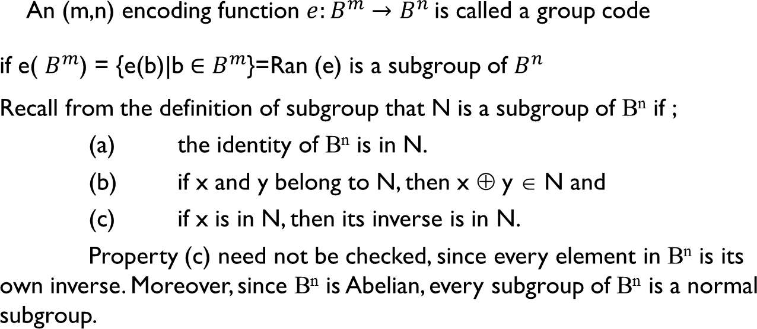
Group Codes
🞂

Slide 50
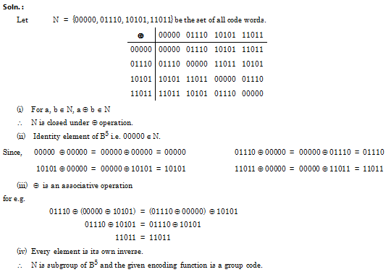
Ex. 1 : Show that the (2, 5) encoding function e : B2 → B5 defined by
e (00) = 00000 e (10) = 10101 e (01) = 01110 e (11) = 11011
code.
is a group

Slide 51
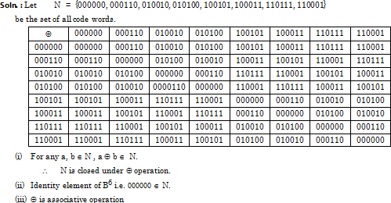

Example 2 : Consider (3, 6) encoding function 'e' as follows.
e (000) = 000000 e (001) = 000110 e (010) = 010010 e (011) = 010100
e (100) = 100101 e (101) = 100011 e (110) = 110111 e (111) = 110001
Show that the encoding function e is a group code.

Slide 52
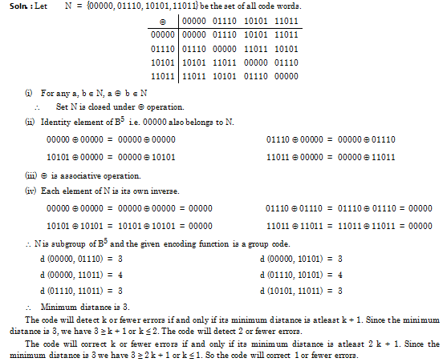
Ex. 3 : Show that the (2, 5) encoding function e : B2 ® B5 defined by
e (00) = 00000 e (01) = 01110 e (10) = 10101 e (11) = 11011
is a group code. How many errors will it detect and correct?

Slide 53
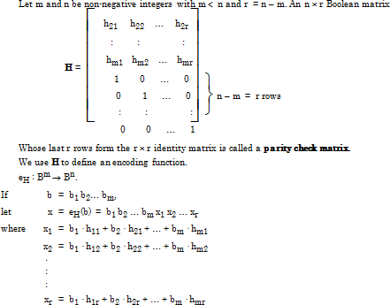
Parity check matrix
snistforum.com

Slide 54
Consider the parity check matrix given by H; H= 1 1 0
0 1 1
1 0 0
0 1 0
0 0 1
Determine the group code e_{H} : B²→B ⁵
snistforum.com

Slide 55
Soln: B² = {00,01,10,11}
Then e(00) = 00 x₁ x₂ x₃ = B ⁵
x₁ = 0 .1 + 0. 0 = 0
x₂ = 0 .1 + 0. 1 = 0
X₃ = 0 .0 + 0. 1 = 0
e (00) = 00000
Next e(01) = 01 x₁ x₂ x₃ = B ⁵
x₁ = 0 .1 + 1. 0 = 0
x₂ = 0 .1 + 1. 1 = 1
X₃ = 0 .0 + 1. 1 = 1
e (01) = 01011

Slide 56
Next e(10) = 10 x₁ x₂ x₃ = B ⁵
x₁ = 1 .1 + 0. 0 = 1
x₂ = 1 .1 + 0. 1 = 1
X₃ = 1 .0 + 0. 1 = 0
e (10) = 10110
Next e(11) = 11 x₁ x₂ x₃ = B ⁵
x₁ = 1 .1 + 1. 0 = 1
x₂ = 1 .1 + 1. 1 = 0
X₃ = 1 .0 + 1. 1 = 1
e (11) = 11101
e_{H} : B²→B ⁵ is as above for e (00) , e (01), e (10) ,e (11)

Slide 57
Problem 1
Consider the parity check matrix given by H; H= 0 1 1
0 1 1
1 0 0
0 1 0
0 0 1
Determine the group code e_{H} : B²→B ⁵

Slide 58
e (00) = 00000
e (01) = 01011
e (00) = 10011
e (00) = 11000

Slide 59
Problem 2
Consider the parity check matrix given by H;
1 1 1
1 0 0
0 1 0
0 0 1
Determine the group code e_{H} : B³→B ⁶
H= | 1 0 | 0
 | 0 1 | 1

Slide 60
e (000) = 000000
e (001) = 001111
e (010) = 010011
e (011) = 011100
e (100) = 100100
e (101) = 101011
e (110) = 110111
e (111) = 111000

Slide 61
MAXIMUM LIKELIHOOD DECODING TECHNIQUE
Consider the encoding function B²→B ⁴ defined as follows
e (00)=0000
e (01)=0110
e (10)=1011
e (11)=1101
Decode the foll words relative to MLD function,
(i) 0101 (ii) 1010 (iii) 1101
Step 1: Construct Decoding Table
 | e(00) | e(01) | e(10) | e(11)
 | 0000 | 0110 | 1011 | 1101
0000 | 0000 | 0110 | 1011 | 1101
0001 | 0001 | 0111 | 1010 | 1100
0010 | 0010 | 0100 | 1001 | 1111
1000 | 1000 | 1110 | 0011 | 0101
Step2: 0101 is decoded as 11
1010 is decoded as 10, 1101 is decoded as 11

Slide 62
Consider the encoding function B²→B ⁵ defined as
follows
e (00)=00000
e (01)=01110
e (10)=10101
e (11)=11011
Decode the following words relative to MLD function, (i) 11110 (ii)10011(iii)10100

Slide 63
 | e (00) | e (01) | e (10) | e (11)
 | 00000 | 01110 | 10101 | 11011
00000 | 00000 | 01110 | 10101 | 11011
00001 | 00001 | 01111 | 10100 | 11010
00010 | 00010 | 01100 | 10111 | 11001
00100 | 00100 | 01010 | 10001 | 11111
01000 | 01000 | 00110 | 11101 | 10011
10000 | 10000 | 11110 | 00101 | 01011
11110 is decoded as 01,
10100 is decoded as 10,
10011 is decoded as 11

